Slide 1
ATAC
2024 Laws
THAT MAY IMPACT YOUR BUSINESS

Slide 2
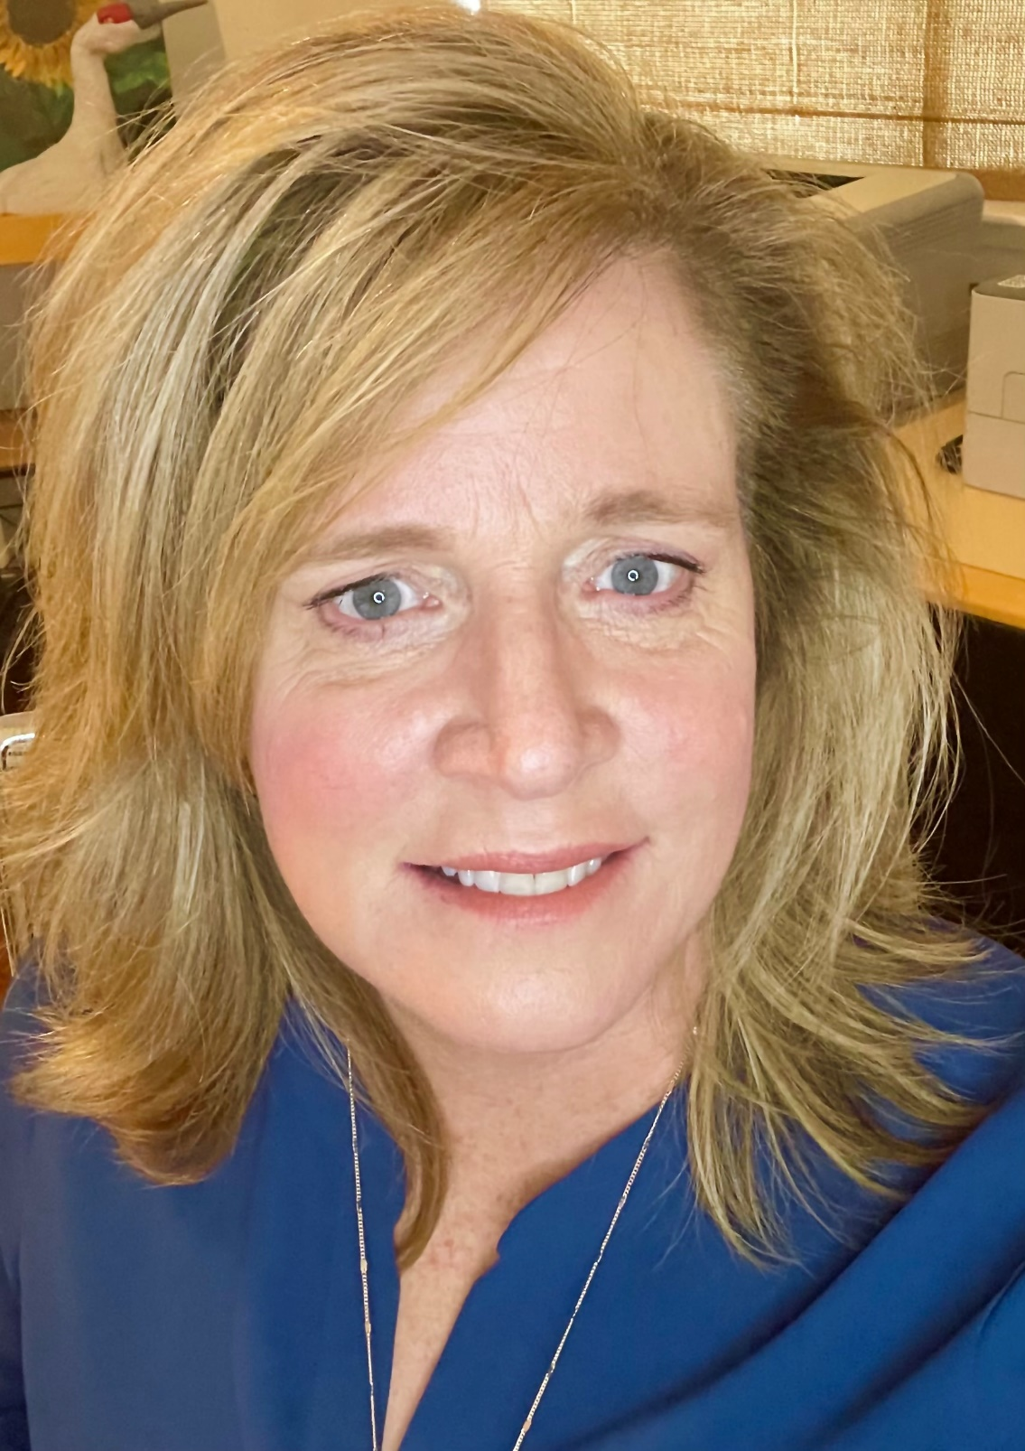
Your Presenter
Sherry Daley
ATAC Adjunct Board Member

Slide 3
NEW STATUTE
WAGES
What bills were passed? Which ones are going into affect? How can I keep track of changes?
What is the current state of California’s minimum wage laws?
TODAY’S TOPICS
REGULATIONS
UPCOMING
What is in the pipeline for regulations?
How does the 2025-26 session look and how can I get involved?

Slide 4
CLICK IN ANY OF THESE TEXT BOXES TO CHANGE THE TEXT SEEN IN THIS TEMPLATE. CUSTOMIZE IT TO FIT YOUR PERSONAL NEEDS.
New Laws
2025 SUNRISE
CHANGE OUT THIS ICON FOR SOMETHING ELSE. RIGHT CLICK AND CHOOSE “CHANGE GRAPHIC” FROM “A FILE.”
FACILITIES, WORKERS, SOBER LIVING
AB 2081 Davies REPORTING
DHCS REVOKED/SUSPENDED PAGE
AB 2574 Valencia REPORTING
RECOVERY RESIDENCE INTERESTS
AB 118 -2023 CERTIFICATION
REQUIREMENTS AND EXTENSIONS
AB 2473 - 2022 REGISTRANTS
80-HOUR REQUIREMENT

Slide 5
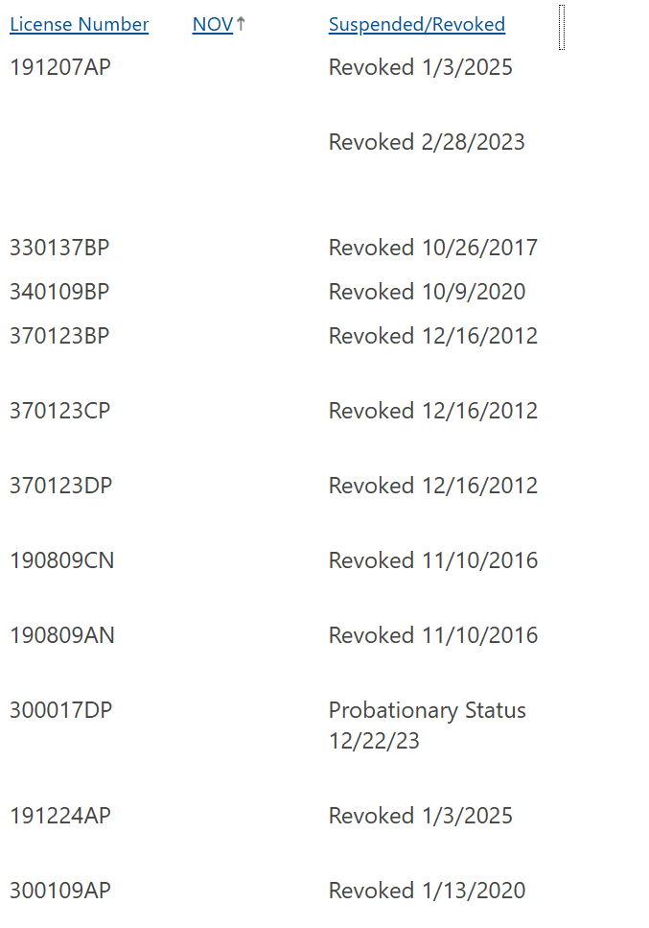
AB 2081 (DAVIES)
WEBSITE REPORTING
https://www.dhcs.ca.gov/provgovpart/Pages/Licensing_and_Certification_Resources.aspx
A bad bill mitigated
AB 2081 would have required an operator of a licensed alcoholism or drug abuse recovery or treatment facility or certified alcohol or other drug program to include a disclosure on its website if the department brought a legal, disciplinary, or other enforcement action and the facility or program was determined to be in violation. This included all disciplinary situations, from something as small as a torn carpet to deaths in the facility.

Slide 6
AB 2574 (Valencia)
RECOVERY RESIDENCE REPORTING
ANOTHER bad bill mitigated
You must now disclose to the department whether the licensee, or a general partner, director, or officer of the licensee owns or has a financial interest in a recovery residence and whether it has contractual relationships with entities that provide recovery services to clients of certified programs or licensed facilities
AB 2574 would have allowed arbitrary indicators of integration with residential treatment and recovery residences to be considered a nonresidential use of the property. The indicators listed in the bill included providing transportation to a program, advertisement connected to a facility, and shared employees. This bill had the potential for a tremendous expansion of an integral facility license. Essentially, any program advertising that it also owns a recovery residence would have to license the recovery residence as part of its residential treatment program.
.

Slide 7

AB 118 (2023)
MANDATORY OUTPATIENT CERTIFICATION
The deadline has passed
This proposal seeks to provide the resources necessary to strengthen LCD oversight for SUD facilities by increasing DHCS presence in Southern California, to build relationships and provide more rapid response time for complaints, and increase quality and safety in the outpatient SUD system of care.
.

Slide 8


CLICK IN ANY OF THESE TEXT BOXES TO CHANGE THE TEXT SEEN IN THIS TEMPLATE. CUSTOMIZE IT TO FIT YOUR PERSONAL NEEDS.
YOUR
POINTS
CHANGE OUT THIS ICON FOR SOMETHING ELSE. RIGHT CLICK AND CHOOSE “CHANGE GRAPHIC” FROM “A FILE.”
Five Year Kick
If AOD certification has not been obtained (i.e., has received certification not in progress/pending), per HSC 11832.18 (b) and (c):
(b) A person or entity found to be in violation of Section 11832.7 shall be prohibited from applying for initial certification for a period of five years from the date of the notice specified in subdivision (a).
(c) The department may levy a civil penalty for a violation of Section 11832.7 in an amount not to exceed two thousand dollars ($2,000) per day for every day the program continues to provide services beyond the date specified in a notice pursuant to subdivision (a).

Slide 9

AB 2473 (2022)
Registrant Requirements
80-hour requirement
still not ready
The bill requires core competency requirements for registered and certified substance use disorder counselors to include, at a minimum, specified elements, including understanding the Diagnostic and Statistical Manual of Mental Disorders and clinical documentation. The bill would require all registrants to obtain 80 hours of core education within the first six months of employment and allows no grace period for those unable to comply with the requirement after July 1, 2025. The bill would exempt counselors in good standing.
.
.

Slide 10
Unanswered Questions
How is education credited?
How much of A-L must be taken?
Who approves the education?
Who pays for the education?
What if a person applies and the education cannot be verified before six months elapse?
Does a person have to re-apply when they finish their education?
Why is this restriction only applied to SUD workers?
Will everything come together by July 1st?
.

Slide 11

A Little Good News
The five-year rule is being eliminated!
.

Slide 12
AB 2121
SB 913
The bill prohibited SUD treatment facilities from being near several specified facilities, including other SUD treatment facilities, community care facilities, and adult day programs.
The bill authorized local governments to take action against recovery residences if they suspect them of conducting treatment and gave these local enforcement agencies the authority to carry out site visits of residential treatment programs.
Notable Industry Wins
AB 3129
No Fee Increase
This bill required private equity groups to provide written notice to, and obtain the written consent of, the Attorney General before a transaction between the private equity group or hedge fund and a health care facility could occur.
Even with rampant inflation, there was no attempt to raise fees… AGAIN.

Slide 13

Get Involved
Continue your ATAC membership!
Join CCAPP at the Addiction Leadership Conference and Lobby Day in March.
Search bills: https://leginfo.legislature.ca.gov/
.

Slide 14
2025: The Year of Regulations???
Pile-Up at OAL
Facility Regulations
ARE YOU READY?
A substantial regulatory update for program licensing has gone through the pre-review process with stakeholders. It is now at the Office of Administrative Law. It should be released “soon.” The release from OAL will be the LAST public forum for input on the new regulations.

Slide 15
Sampling of regs changes
(29) “Owner” means having an ownership interest of 5% or more in a business entity.
(40) “Site Visit” means a physical or virtual inspection of a residential alcoholism or drug abuse recovery or treatment facility conducted by any authorized employee of the Department.
(43) “Synchronous Interaction” means the same as defined in Business and Professions Code Section 2290.5(a)(5). A resident shall be present at a residential alcoholism or drug abuse recovery or treatment facility for services provided through synchronous interaction.
.

Slide 16
Sampling of regs changes (applications)
(28) Written policies and procedures for when a resident relapses or appears to be under the influence;
(4) The applicant identified on the application, information and forms has operated or been affiliated with a facility that has a history of being in non-compliance with the provisions of Chapter 7.5 (commencing with Section 11834.01), Part 2, Division 10.5 of the Health and Safety Code and the requirements of this chapter;
.

Slide 17
Sampling of regs changes (fines)
.
Civil Fines:
(1) The Department shall assess a civil penalty of two hundred fifty ($250) twenty five ($25) dollars per day against the licensee for each Class C deficiency.
(2) The Department shall assess a civil penalty of three hundred seventy-five ($375) fifty ($50) dollars per day against the licensee for each Class A or B deficiency.
(3) The Department shall assess a civil penalty of five-hundred ($500) dollars per day against the licensee for each Class A deficiency.

Slide 18
Sampling of regs changes (fines)
.
Repeat Civil Fines:
(c) If the licensee repeats the same deficiency violation within a twenty-four (24) 12-month period, the Department shall assess an immediate civil penalty against the licensee of five hundred ($500)one hundred fifty ($150) dollars. Additionally,Tthe Department shall also assess a civil penalty of seven-hundred fifty ($750) dollars for each day the deficiency continues until the licensee from the date specified in the notice of deficiency until the submits written verification of the correction pursuant to Section 10545.

Slide 19
Sampling of regs changes (denials)
.
Grounds for Revocation:
(6) Holds multiple licenses issued by the Department, or any licensee holds a five percent (5%) or more ownership interest in one or more other licenses issued by the Department, and the Department revokes one or more of those licenses; or
24-hour Notice Requirement:
(A1) Death of any current resident from any cause.
(2) Death of any person that occurs at the facility.
(B3) Any facility related iInjury or change in medical condition of any resident which requires emergency medical treatment.

Slide 20
Sampling of regs changes (drug-free)
.
Drug-free Campus:
§10563. Accountability.
The licensee, whether an individual or other entity, is accountable for the general supervision of the residential alcoholism or drug abuse recovery or treatmentlicensed facility, ensuring an alcohol and drug free environment, and for the establishment and implementation of policies concerning its operation.

Slide 21
Sampling of regs changes (drug-free)
.
Drug-free Campus:
New Language:
A program is responsible for providing an environment that promotes effective delivery of AOD services, including taking reasonable measures to minimize the risk of alcohol and/or drugs from entering the premises. A program shall have a written policy that identifies:
Requirements for individuals to enter and re-enter the premises;
Regular inspections of the premises, including any exterior spaces such as a backyard;
Procedures in the event alcohol and/or drugs are found on the premises, including delivery of AOD services following a relapse.

Slide 22
Sampling of regs changes (contracts)
.
§10563.5. Provision of Services.
The licensee is responsible for the provision of all alcoholism or drug abuse recovery or treatment services. The licensee shall not enter into a management services/professional services agreement for the provision of any alcoholism or drug abuse recovery or treatment service. Management services/professional services agreement(s) shall be limited to services such as the following: IMS, facility maintenance, custodial, bookkeeping, landscaping and food services.

Slide 23
Sampling of regs changes (detox)
.
Detox Staff Requirements:
(4) Staff who provide or supervise detoxification services shall meet the following requirements:
(A) Complete six (6) hours of orientation training that specifically addresses the provision of detoxification services including physical checks and appropriate documentation, prior to providing or supervising these services.
(B) Repeat orientation training specified in paragraph (4)(A) after a break in employment of more than one hundred eighty (180) consecutive days.
(C) Complete eight hours (8) of training on an annual basis that covers the needs of residents who receive detoxification services.

Slide 24
Sampling of regs changes (intoxication)
Under the Influence:
(ef) No person, who, within the previous 24 hours, has consumed, used, or is still otherwise under the influence of alcohol or drugs as specified in section 10501(a), shall be permitted on the premises except for individuals admitted for detoxification or withdrawal. The licensee shall have specific written rules and policies and procedures to enforce this provision. to follow if a person on the premises is under the influence, or appears to be under the influence, of alcohol or drugs or has used alcohol or drugs within the past twenty-four (24) hours.
.

Slide 25
Sampling of regs changes (detox)
Detoxification Services:
a) During the first seventy-two (72) hours following admission of a resident for detoxification services, staff shall perform a:
(1) Physical check at least once every thirty (30) minutes; and
(2) Vital signs check including blood pressure, pulse oximetry, heart rate, and respiratory rate, at least once every six (6) hours.
(b) Staff shall document the physical check and vital signs check at the time performed. The failure to document shall be deemed by the Department as a missed physical check and/or a missed vital signs check.
.

Slide 26
Sampling of regs changes (detox)
Detoxification Services:
(e) For every ten (10) residents receiving detoxification services, a licensee shall have a minimum of one (1) staff trained in providing detoxification services, who is on duty, awake, and physically present at the facility assigned exclusively to provide detoxification services. During the provision of detoxification services, there shall be at least one (1) staff on duty at all times physically present in the facility who is capable of providing cardiopulmonary resuscitation and first aid.
(f) A licensee shall have a written process to transition residents from detoxification to treatment and/or recovery services. The written process shall include documenting a referral as appropriate for each resident.
.

Slide 27
Sampling of regs changes (PCP Auth.)
IMS Certification:
(a) Within seventy-two (72) hours following admission, an HCP shall request a written consent from each resident authorizing the HCP to communicate with their primary care provider. The written consent shall be placed in a resident’s record.
(b) If a resident does not have a primary care provider, an HCP shall provide a list of providers located in the general area within seventy-two (72) hours following admission.
.

Slide 28
Sampling of regs changes (physicians)
IMS Certification:
(d) A physician shall be:
(1) Available for consultation either in person or by telephone at all times; and
(2) Responsible for the supervision of HCPs that are not physicians which shall include reviewing, signing, and dating resident records within seven (7) days of treatment provided by HCPs that are not physicians .
(e) A HCP that is not a physician shall provide IMS under the supervision of a physician.
.

Slide 29
Other Regulation Packages
???
Upcoming
Counselor and Outpatient Certification
Drafts of counselor and outpatient certification are being developed. The timeline is unknown.

Slide 30
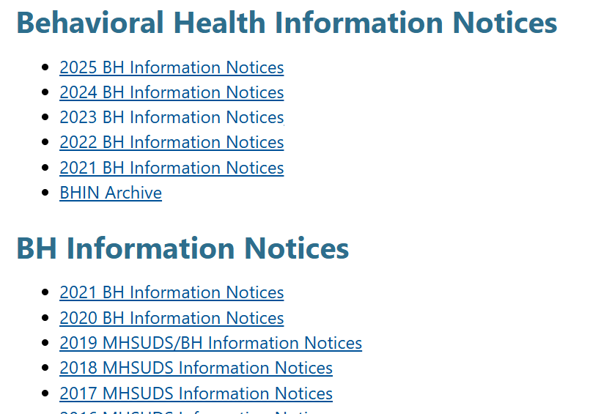
Read you BHINs
They Matter!!
Archive:
https://www.dhcs.ca.gov/formsandpubs/Pages/Behavioral_Health_Information_Notice.aspx.

Slide 31

CLICK IN ANY OF THESE TEXT BOXES TO CHANGE THE TEXT SEEN IN THIS TEMPLATE. CUSTOMIZE IT TO FIT YOUR PERSONAL NEEDS.
YOUR
POINTS
CHANGE OUT THIS ICON FOR SOMETHING ELSE. RIGHT CLICK AND CHOOSE “CHANGE GRAPHIC” FROM “A FILE.”
Wage-flation
A minimum wage increase for health care workers in California went into effect on October 16, 2024. The change was originally slated to take effect this past June, after California enacted Senate Bill (“SB”) 525 in the fall of 2023. Over the summer Senate Bill 159 delayed the implementation of the increase due to concerns over the impact on the California budget.

Slide 32
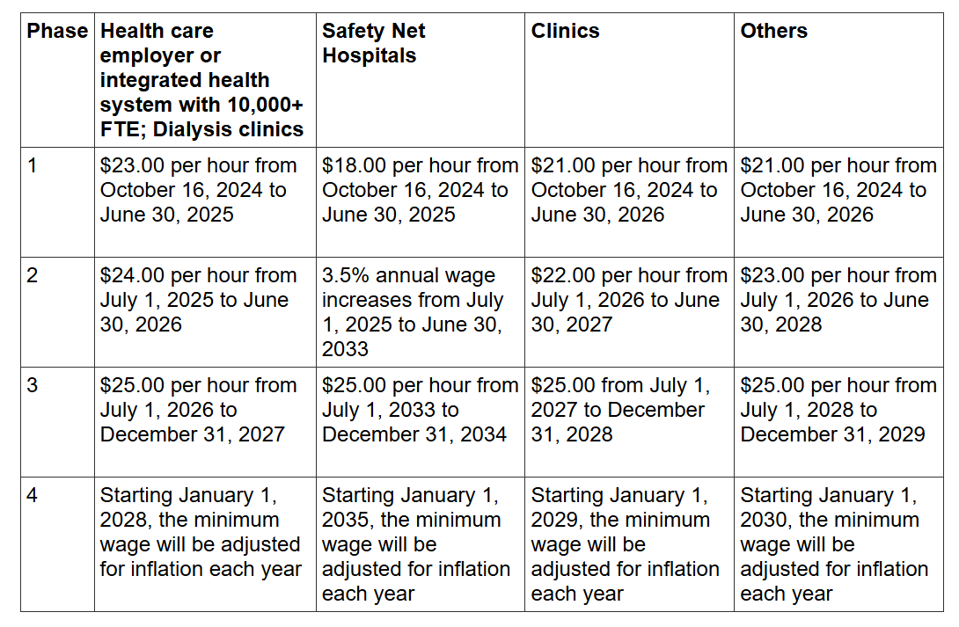
Wage Progression
.

Slide 33
Do these wages apply to you?
.
1182.15.
(a) The Legislature finds and declares as follows:
(1) Workers in the health care industry, including workers at general acute care hospitals, acute psychiatric hospitals, medical offices and clinics, behavioral health centers, and residential care centers provide vital health care services to California residents, including emergency care, labor and delivery, cancer treatments, and primary and specialty care. Similarly, dialysis clinics provide life-preserving care to patients with end-stage renal disease and are part of the continuum of kidney care that also includes hospitals and health systems. Residents and visitors to the state rely on access to this high-quality health care.

Slide 34
2025-2026 Session
Still a
defensive year
State Auditor’s Report
Calls for greater “accountability”
Swing toward a “new war on drugs” – Prop 36
General frustration

Slide 35
ATAC and CCAPP Join Forces
Anti-Curbing Bill
Prohibits pre-authorization
Prohibits concurrent review
Great author
Great potential sponsors and support

Slide 36

CLICK IN ANY OF THESE TEXT BOXES TO CHANGE THE TEXT SEEN IN THIS TEMPLATE. CUSTOMIZE IT TO FIT YOUR PERSONAL NEEDS.
YOUR
POINTS
CHANGE OUT THIS ICON FOR SOMETHING ELSE. RIGHT CLICK AND CHOOSE “CHANGE GRAPHIC” FROM “A FILE.”
A Heavy Lift
“In a room where people unanimously maintain a conspiracy of silence, one word of truth sounds like a pistol shot.”
Czesław Miłosz

Slide 37
Questions??

